Slide 1

ECHOCARDIOGRAM
Name of the Students : SAPPASATYAHARSHA
Register Number: 40111142
SUPERVISOR – Dr.D.Sudha ,M.E.,Ph.D.,

Slide 2


Slide 3
Presentation Outline
Introduction
Objectives
System Architecture / Ideation Map
Module Implementation
Results and Discussions
Conclusion
References

Slide 4
Introduction
Machine Learning(ML) is a branch of Artificial Intelligence(AI) & Computer Science which focuses on the use of data and algorithms to imitate the way that humans learn and gradually improving accuracy
During an echocardiogram, a doctor will generate a real-time image of the heart. The test monitors ultrasound, high-frequency sound waves, which are projected through the chest and bounce back to create an image of your heart.
All the patients suffered heart attacks at some point in the past. Some are still alive and some are not. The survival and still-alive variables, when taken together, indicate whether a patient survived for at least one year following the heart attack.
Decision Tree is the most important support tool with a tree-like structure that models probable outcomes, cost of resources, utilities and possible consequences of supervised learning.
The problem addressed by past researchers was to predict from the other variables whether or not the patient will survive at least one year. The most difficult part of this problem is correctly predicting that the patient will NOT survive. (Part of the difficulty seems to be the size of the data set.
Problem Statement : The classification goal is to predict still-alive using features from 3 to 10

Slide 5
Objectives
The objective of the project is to find how to use machine learning techniques for analysis and making predictions using echocardiogram dataset . To find The classification goal is to predict still-alive using features from 3 to 10 . The survival and still-alive variables, when taken together, indicate whether a patient survived for at least one year following the heart attack.
This report examines how to use machine learning techniques to analyze and predict using echocardiogram dataset.
This data set is used for exploratory data analysis, data visualization, dealing with missing values and classification modelling techniques
An ECG should be attached ensuring good tracings to facilitate the acquisition of complete digital loops. Loops should be examined and adjusted accordingly in order to ensure a clear representation of the image acquired.

Slide 6
Objectives
There are three main types of echocardiogram tests that a doctor may perform.
A transthoracic echocardiogram is noninvasive. It uses a transducer moved across your chest to produce the heart image.
A transesophageal echo test is performed with a tube transducer in your throat. This helps to view the heart from a different angle.
Last, a stress echocardiogram occurs during exercise on a treadmill or bike. This is to monitor your heart’s response to physical activity.
The test is useful for diagnosing and monitoring heart problems and creating treatment plans.

Slide 7
System Architecture / Ideation Map
Import all the necessary Modules(numpy,pandas,matplotlib etc.)
Analyse the Result
Importing the DataSet (CSV) file to Jupiter Notebook
Running the TestCases of the program
Performing Exploring Data Analysis(EDA)
Using Random Forest Classification Method
For prediction
Getting Dummies of the Data

Slide 8
Project Implementation
In this project I will demonstrate how to predict still alive from 3 to 10 in Python using the following steps:
Data preparation
Exploratory Data Analysis
Analyzing the correlation to numerical features
Encode categorical features
Using Machine Learning Decision Tree’s echocardiogram Algorithm for getting output
Hardware & Software Requirements:
4GB RAM
Operating System
Windows 10,Core i5
Anaconda Navigator along with Python 3.8

Slide 9
Project Implementation
Construction of the Project : The dataset used for this project relates to direct marketing campaigns of a Portuguese banking institution. The purpose of building the models is to predict whether the client will subscribe for a term deposit. In order to accomplish the project problem, the proposed solution can be described in following steps:
Step.1: identifying the problem, collecting, describing the dataset
Step.2: Exploring, data cleaning and preparation
Step.3: Building the models
Step.4: Test and evaluate the performance of the models
Metrics : The evaluation metrics proposed are appropriate given the context of the data, the problem statement, and the intended solution. The resulting image of an echocardiogram can show a big picture image of heart health, function, and strength. For example, the test can show if the heart is enlarged or has thickened walls. Walls thicker than 1.5cm are considered abnormal. They may indicate high blood pressure and weak or damaged valves. An echocardiogram can also measure if your heart is pumping enough blood through your body.

Slide 10
Project Implementation
Survival : The number of months patient survived (has survived, if patient is still alive). Because all the patients had their heart attacks at different times, it is possible that some patients have survived less than one year but they are still alive. Check the second variable to confirm this. Such patients cannot be used for the prediction task mentioned above.
Still-alive : A binary variable that depicts if the patient is still alive (0: dead at end of survival period, 1: still alive)
Age-at-heart-attack : Age in years when heart attack occurred
Pericardial-effusion : Pericardial effusion is fluid around the heart (0: no fluid, 1: fluid)
Fractional-shortening : A measure of contractility around the heart, lower numbers are increasingly abnormal

Slide 11
Project Implementation
Epss : E-point septal separation, another measure of contractility. Larger numbers are increasingly abnormal
Lvdd : Left ventricular end-diastolic dimension. This is a measure of the size of the heart at end-diastole. Large hearts tend to be sick hearts
Wall-motion-score : A measure of how the segments of the left ventricle are moving
Wall-motion-index : Equals wall-motion-score divided by number of segments seen. Usually 12-13 segments are seen in an echocardiogram. (Preferable to use this variable INSTEAD of the wall motion score)
Mult : A derivate variable (suggested that it can be ignored)
Name : The Name of the patient (Has benn replaced with "name" entirely)
Group : Group (Has been considered meaningless and suggested to ignore)
Alive-at-1 : It is a Boolean-valued variable derived from the first two attributes. (0: patient was either dead after 1 year or had been followed for less than 1 year, 1: patient was alive at 1 year)

Slide 12
Methodology
Data Exploration:
The data that is used in this project originally comes from the UCI machine learning repository. This intermediate level data
set has 132 rows and 12 columns.
The data set provides data that could be used for classifying if patients will survive for at least one year after a heart attack.
All the patients suffered heart attacks at some point in the past. Some are still alive and some are not.
The survival and still-alive variables, when taken together, indicate whether a patient survived for at least one year following the heart attack.

Slide 13
Methodology
In this project, we are going to utilize python to develop a predictive machine learning model! begin by loading our data and exploring the columns.
The problem addressed by past researchers was to predict from the other variables whether or not the patient will survive at least one year.
The most difficult part of this problem is correctly predicting that the patient will NOT survive. (Part of the difficulty seems to be the size of the data set.)
This data set is recommended for learning and practicing your skills in exploratory data analysis, data visualization, dealing with missing values and classification modelling techniques.

Slide 14
Methodology
Data reading and Preparation :-
The library can also be used for data-mining and data analysis. The main machine learning functions that the Scikit-learn library can handle are classification, regression, clustering, dimensionality reduction, model selection, and preprocessing.
library(ggplot2)
library(caret)
library(rpart)
library(rpart.plot)
library(dplyr)
library(tidyr)
library(DataExplorer)
library(FFTrees)
data <- read.csv("../input/echocardiogram.csv", sep =',', na.strings = c('NA','?'))
str(data)

Slide 15
Methodology
This is the representation of the data sets that can be variables which were using in the echocardiogram
Here we are using all the 123 variables with the values
## 'data.frame’ : 133 obs. of 13 variables:
## $ survival : num 11 19 16 57 19 26 13 50 19 25 ...
## $ alive : int 0 0 0 0 1 0 0 0 0 0 ...
## $ age : num 71 72 55 60 57 68 62 60 46 54 ...
## $ pericardialeffusion : int 0 0 0 0 0 0 0 0 0 0 ...
## $ fractionalshortening : num 0.26 0.38 0.26 0.253 0.16 0.26 0.23 0.33 0.34 0.14 ...
## $ epss : num 9 6 4 12.1 22 ...
## $ lvdd : num 4.6 4.1 3.42 4.6 5.75 ...
## $ wallmotion.score : num 14 14 14 16 18 12 22.5 14 16 15.5 ...
## $ wallmotion.index : num 1 1.7 1 1.45 2.25 ...
## $ mult : num 1 0.588 1 0.788 0.571 ...
## $ name : Factor w/ 2 levels "","name": 2 2 2 2 2 2 2 2 2 2 ...
## $ group : Factor w/ 4 levels "","1","2","name": 2 2 2 2 2 2 2 2 2 2 ...
## $ aliveat1 : int 0 0 0 0 0 0 0 0 0 0 ...

Slide 16
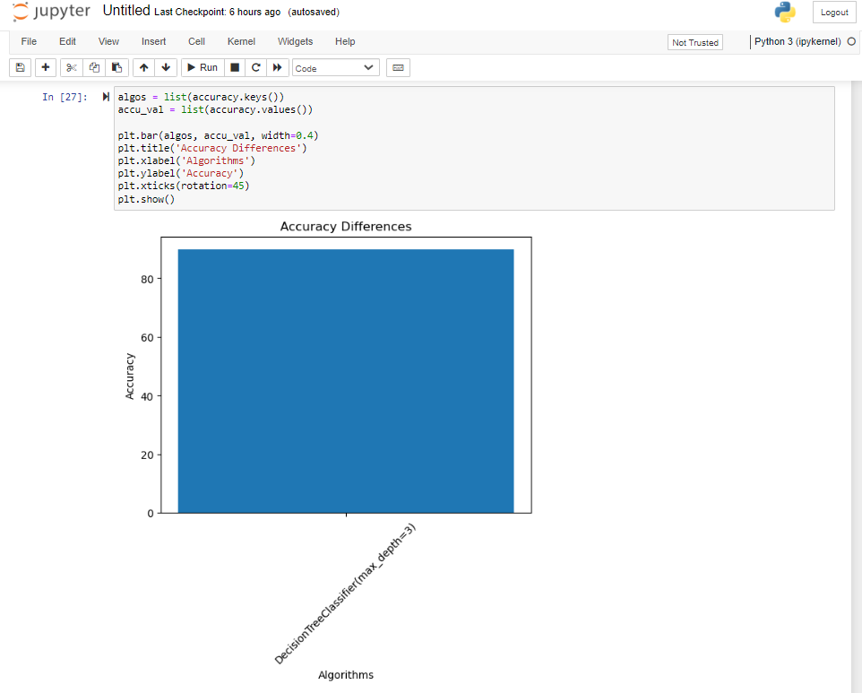
Results and Discussion
The Decision tree we used are calculated using sklearn wrapper so can be trusted for the model performance. Our end goal was to have a Trained model that could beat the untuned benchmark which it did by a very fine margin. So the solution described below is satisfactory to our initial expectations. We generated a final model with above list of tuned parameters.

Slide 17
Conclusion
Machine learning techniques are widely used data analysis methods in various business and industrial sectors.
The main reason for that because ML can build predictive models to produce better predictions and achieve the desired level of accuracy, leading to better outcomes.
The main challenges in data analysis are data preparation and cleaning, the selection of appropriate models and attributes used in their implementation.
The aim of the project is how to use machine learning techniques for analysis and making predictions using to determine if the person’s heart is working properly or has significant problems.
Heart defects are generally diagnosed in infants and children, but can be found in adults too. Echos can even be done during pregnancy to check for fetal issues.
By checking size, pumping strength, and heart rate, your doctor can find defects. A heart defect can be a hole in a chamber or improper connections between the heart muscles and arteries.

Slide 18
References
 | Here we are providing the reference links which we have followed during the project work https://www.kaggle.com/loganalive/echocardiogram-dataset-uci/report#missing-value-treatment-- https://specialistdirectinc.com/telecardiology-articles/uncategorized/a-guide-to-understanding-echocardiogram-results/ https://code.datasciencedojo.com/datasciencedojo/datasets/tree/master/Echocardiogram https://erp.bioscientifica.com/view/journals/echo/2/1/G9.xml https://www.nature.com/articles/s41746-018-0065-x

Slide 19
THANK YOU

